Slide 1
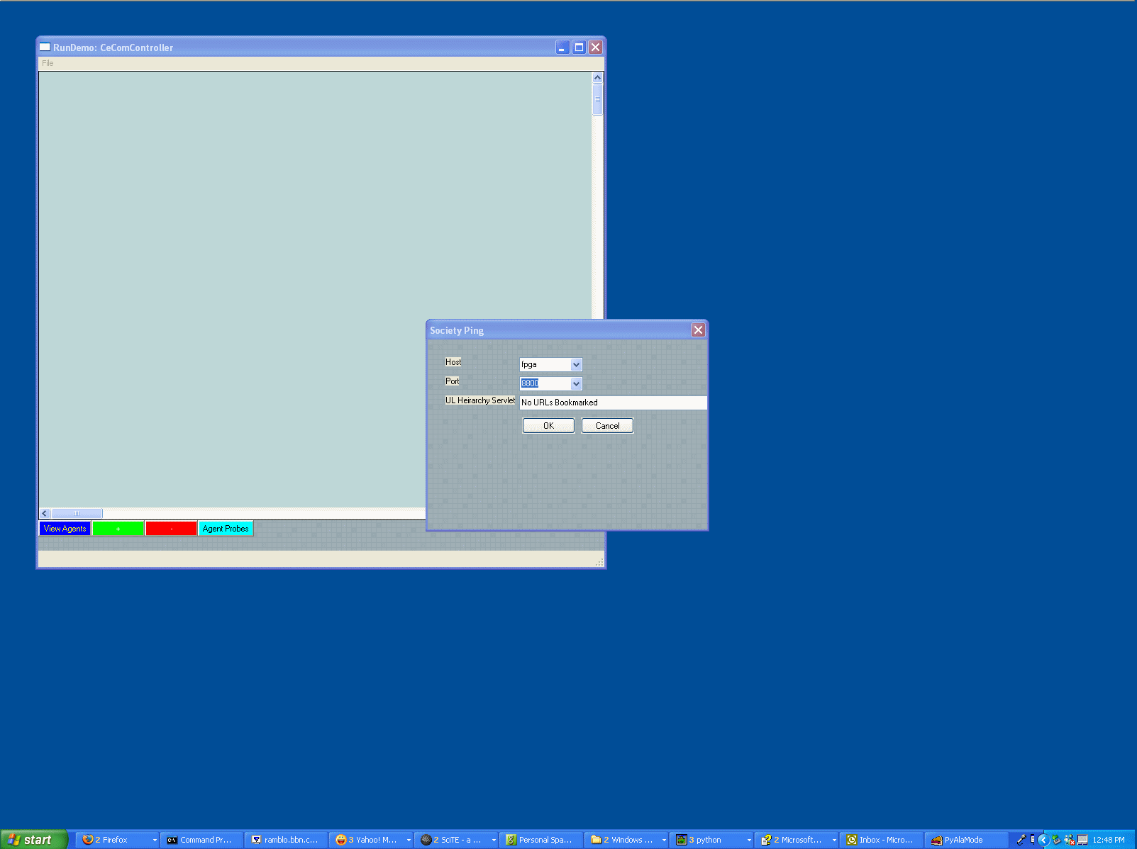
Start CECOMAgentViewer from the desktop.
Choose a host and a port from which an agent root display is visible
Choose [OK]
Next Slide

Slide 2
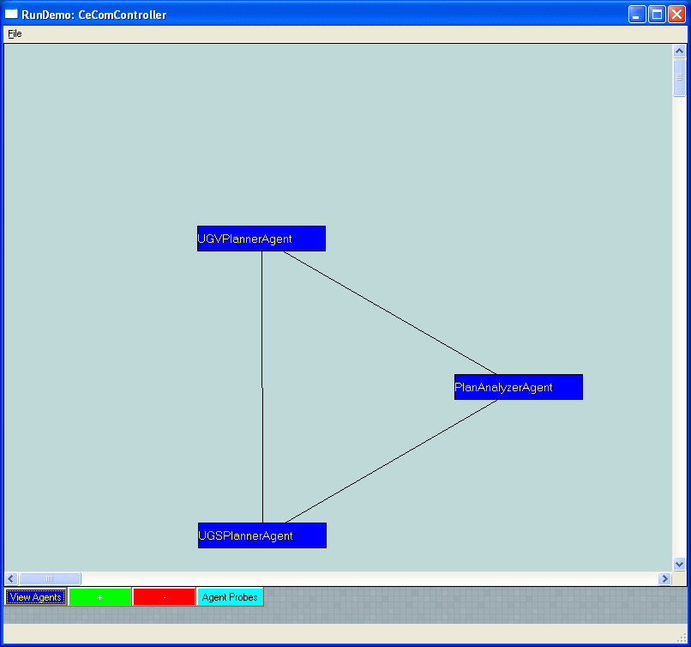
The society auto-lays out in a fully connected graph
Choose [Agent Probes]
Next Slide

Slide 3
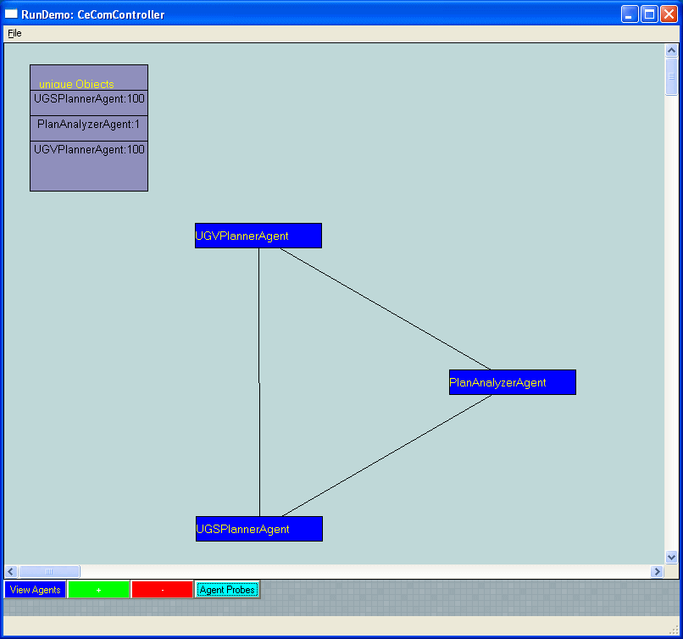
←This Information Panel is derived from a screen scrape

